Slide 1
Club Treasurer Seminar Presented at Indiana Lions Leadership Conference November 5, 2016 – Plainfield, IN Presented by PDG Marty Juel

Slide 2
Agenda
Review position responsibilities
Identify benefits “MyLCI” provides club treasurers
Review role specific “MyLCI” features and functions
Review options to keep records
Review tax and other regulatory issues
Notes:
We know that our club officers are some of the busiest people in their club. Through this virtual training session we hope to help you quickly learn to use some tools designed to make it easier to fulfill your role as a club treasurer. Today we are going to:
* Perform a high level review of your responsibilities as club treasurer
* Identify the benefits of using "MyLCI"
Show you the "MyLCI" functions and features that will assist you in fulfilling your role.
Review options to keep records
Review tax and other regulatory issues

Slide 3
Club Leadership Teamwork
Club
Goals
Notes:
Before we begin discussing your responsibilities and how you will perform some of your duties, I want to remind you that you are a part of a team, the club leadership team. It is the responsibility of the club leadership team to * guide members toward reaching the club’s goals.
* Clubs are encouraged to use teamwork to achieve club goals including the Club Quality Initiative (formerly the Club Excellence award) and these goals can be accomplished when everyone embraces the dynamic of teamwork. Each officer has a piece of the puzzle that will complete the bigger picture of achieving club excellence. By working together, your club will be able to meet its full potential and serve a vital role in your community.

Slide 4
Club Treasurer Responsibilities
Receive and deposit monies into approved bank
Pay club obligations authorized by the board of directors
Keep and maintain general records of club receipts and disbursements
Notes:
The club treasurer is responsible for the financial matters pertaining to the club. As you are aware, while serving as club treasurer some of your primary responsibilities will be to: * Receive and deposit money from the secretary, and others, into the recommended and approved bank. Remember, your club must establish an administrative account and a public or fundraising account.
* You will pay the club’s obligations with checks or vouchers that are signed by yourself and countersigned by another officer. As we will discuss a little later, you may now agree to pay dues online if the board approves of this payment option.
* You will have custody of and maintain club receipts and disbursements.

Slide 5
Club Treasurer Responsibilities
Prepare and submit regular financial reports
Give bond for the faithful discharge of your office in sum and with surety
Deliver financial accounts, funds, and records to your successor
Notes:
* Prepare and submit regular reports to your club’s board of directors and be aware of municipal and/or government filing requirements for your area.
* Provide a personal guarantee or actual bond to safeguard club assets
* And deliver, in a timely manner at the conclusion of your term in office, the financials of the club to your successor.
I encourage you to take the “Club Treasurer” self-study course that is available on the Leadership Resource Center. It dives deeper into the responsibilities and tasks associated with your role that we will not have the opportunity to cover during this session.

Slide 6
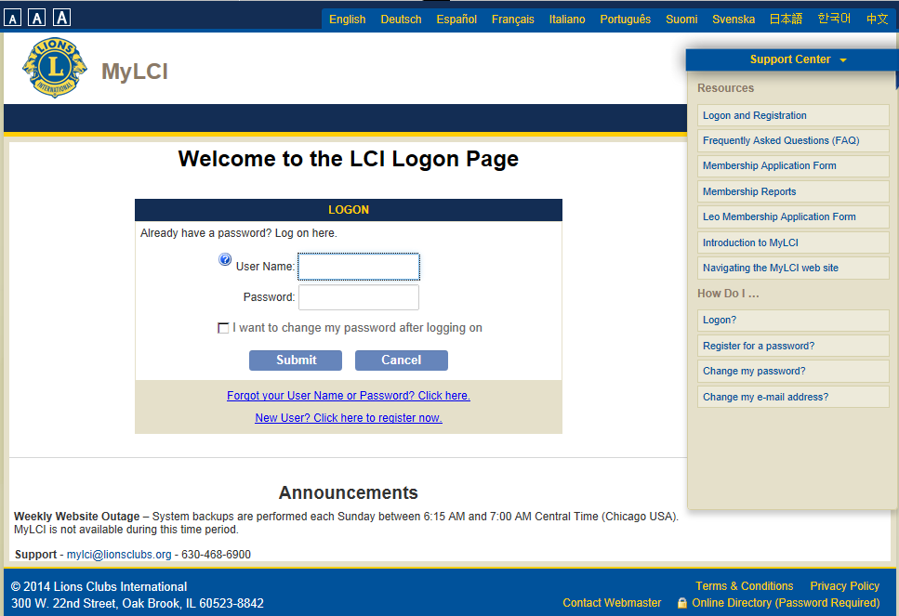
“MyLCI”
MyLCI
Notes:
You have heard the term "MyLCI" a few times thus far in our session, but may be wondering “what is it exactly”?!
As club treasurer, you have access to MyLCI. On the website you will find: *
A consistent look that matches the Lions Clubs International site
The use of common user controls that are currently used on the web today and supported across browsers
No need for a user guide
Informative and understandable error notifications and transaction acknowledgements
And Support for internet browser including Internet Explorer, Firefox, Safari, and Chrome

Slide 7
“MyLCI” and the Club Treasurer
View membership
Access and download club statements and per capita invoices
Notes:
The new “MyLCI” provides some key features that will greatly benefit you. “MyLCI” allows you to:
* view your membership, which helps in preventing billing errors. You can also confirm if new members were entered correctly, especially if they are student or family members as billing is issued according to membership types.
* Another key benefit you will see from using “MyLCI” is the ability to access and download club statements. Now you can view statements dating back as far as December 2010.

Slide 8
“MyLCI” and the Club Treasurer
View membership
Access and download club statements and per capita invoices
Opt-out of paper copies
Make online payments
Notes:
* You can also opt out of receiving paper statements. This feature helps the environment, alleviates the potential of the late arrival of mailed statements, allows per capita errors to be identified and corrected in a timely manner, and lowers the postage cost for the association!
* Lastly, “MyLCI” provides enhanced payment options. As I mentioned briefly earlier, club treasurers now have the option to make payments online. This allows for next business day payment posting and promotes “Active” status for the club.
With these great benefits, we hope to see a drastic increase in the number of club treasurers that are registered with and using the site.

Slide 9
"MyLCI" Preview
Training Site
“MyLCI” Access and Login
Site Overview
Viewing Members
Club Statements
Opt-out of receiving paper statements
Make Payments
Reports
Notes:
What I am going to cover is not going to be that much different for our returning officers that are joining us today. The steps may have changed and you may recognize that some buttons and/or fields are in different locations, but for the most part it should be an easy transition for you. To our new officers, these steps should prove easy for you to follow as well.
* So let’s start by talking about the training site. It’s available for a short period prior to July 1 to help new treasurers become familiar with MyLCI.

Slide 10
"MyLCI" Preview
Training Site
“MyLCI” Access and Login
Site Overview
Viewing Members
Club Statements
Opt-out of receiving paper statements
Make Payments
Reports
Notes:
We are now going to move on to * accessing and logging into “MyLCI.”

Slide 11
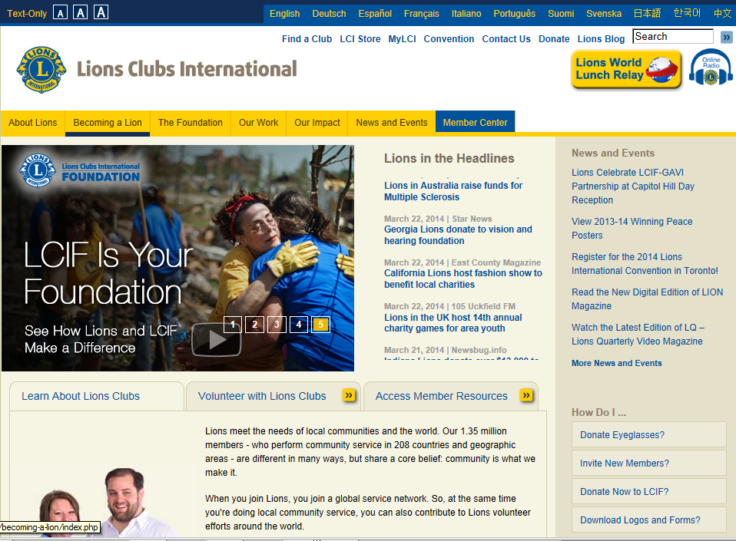
Notes:
To access “MyLCI,” click on * the MyLCI link at the top of the associations main page.

Slide 12
14
Notes:
If you used MyLCI in the past, you will be able to use your previous * username and password to access MyLCI. If you have forgotten your password, simply * click the “Forgot your User Name or Password?” link, where you will be prompted to answer one of your security questions.
If you are a new officer, you will need to create your username and password by * clicking the “New User? Click here to register now” link and following the screen prompts. Let’s assume that everyone is a first-time officer and have never used MyLCI before and click this link to create an account.

Slide 13
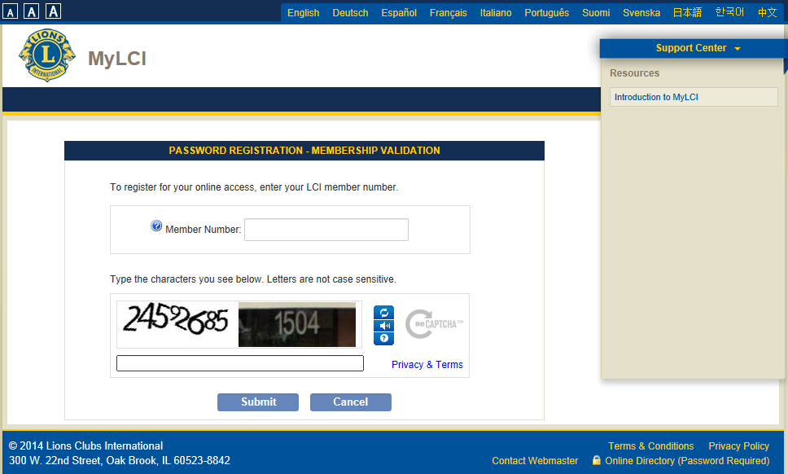
14
Notes:
On the next page you are prompted to * enter your member number, * type the letters displayed in the word verification box, and * click submit. If you don’t know your member number, look at the letter/e-mail that was sent to you when the new officers were reported. Your previous club secretary, president, or the district office can also provide you with your member number. You can also find it on your previous per capita invoices.

Slide 14
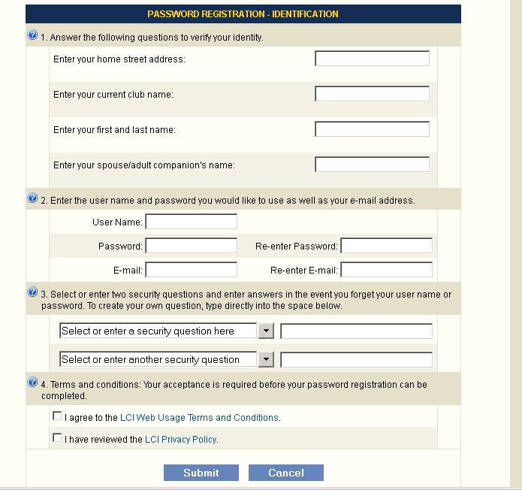
16
Notes:
In the next section you are prompted to enter your address, club name, your first and last name, and your spouse companion’s name.
* Next you enter the user name and password you will use to access MyLCI. Passwords ARE case sensitive. You will also enter your e-mail address twice. You must be the only person using this email address in our system. Both of these requirements help to protect the privacy of your club member’s data.
* Next you will select two security questions from the pre-defined list, or type your own, and enter their answers. These questions will be used to help you if you forget your user name or password. The answers are also case sensitive.
* Lastly, you will then need to agree to the terms and conditions associated with the site, review the privacy policy and * click Submit;
* after which you will receive your confirmation of registration.

Slide 15
16
Notes:
The next time you want to login to MyLCI, you will simply enter your * user name and password on the MyLCI logon page.

Slide 16
"MyLCI" Preview
Training Site
“MyLCI” Access and Login
Site Overview
Viewing Members
Club Statements
Opt-out of receiving paper statements
Make Payments
Reports
Notes:
Thus far, we started at the Lionsclubs.org website and navigated to the “MyLCI” logon page. Then because we hadn’t previously registered a user name and password we went through the registration process. Remember you only need to perform the registration process once if you have never accessed the site before. In the future, you will simply type your user name and password in the “MyLCI” logon page.
* Now I going to review the site’s overview.

Slide 17
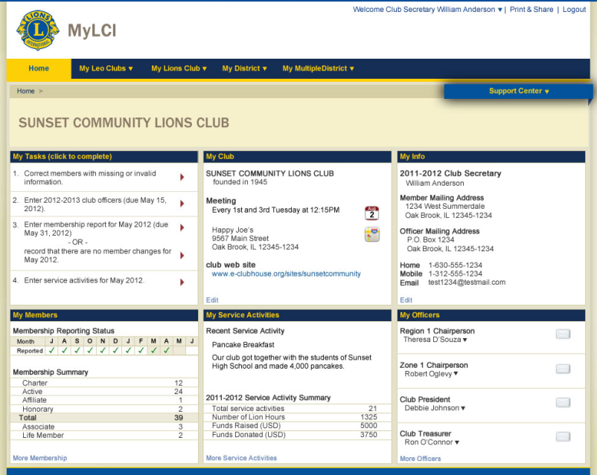
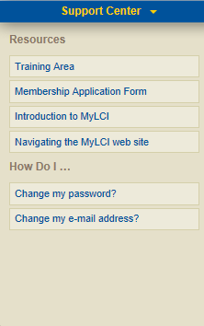
19
Notes:
Once your term has started, after logging in you will see the Club Officer Home page. * The officer or chairperson roles that are active in our database for you will be displayed. On this page, you will also see what we call the Support Panel on the right side. This section contains information to help you use the web site.* Click on this blue Support Center bar to maximize the Support Center so you can see more of its assistance features. Here you will see the link to access * the Training Area.
When you want to see less of the Support Center and more of your main page, * click on the minimize icon * .
* The menu at the top of your page may not look like this one, for the menu options displayed vary according to role. The menu is different depending on the role that you have. The district governor will see different options than a Club President and Club Secretary. The zone and district level can see club level reports.
* You will see a “My Leo Club” menu option if your club sponsors one or more Leo clubs.
* Select “My Lions Club” for links pertaining to the Lions club where your primary membership is.
* The “My District/My Multiple District” links contain information about your district or multiple district and the officers and chairpersons, officers and conventions.
Next, let’s look at each of the sub-sections or panels in more detail.

Slide 18
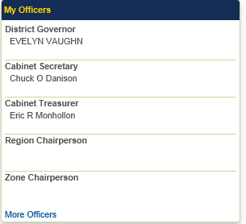
20
Notes:
In the middle of the page you will see some small subsections or panels with information specific to your club.
* The “My Tasks” section shows a list of tasks customized to your role and your club. In this panel, you see a notification that a member has a missing or invalid number. To take action on a task in this section, you can simply * click on the red arrow and the web page you need to take care of that task will be displayed.
* The “My Members” section shows your club’s membership reporting status and the count of members by member type. * We can see that this club has reported their membership status every month except May.
* The “My Club” section displays the information on your club meetings that is in the data base. This is the same information that users of the Lionsclubs.org / “Find a Club” feature will see. You can click on the * “Edit” link to update your meeting information.
* The “My Service Activities” panel displays your club’s most recent service activity and a summary of your club’s service activity for the year. The “More Service Activities” *link will take you to the main service activity page where you can add, update and search for service activities.
* The “My Info” section displays your own contact information. You can click the Edit link to update your contact information.
* The “My Officers” section shows your Region and Zone officers as well as the other members of your club’s leadership team.

Slide 19
"MyLCI" Preview
Training Site
“MyLCI” Access and Login
Site Overview
Viewing Members
Club Statements
Opt-out of receiving paper statements
Make Payments
Reports
Notes:
Now that you have logged on and know how to navigate “MyLCI” using menus and the support center panel, * you are now ready to view your club’s members.

Slide 20
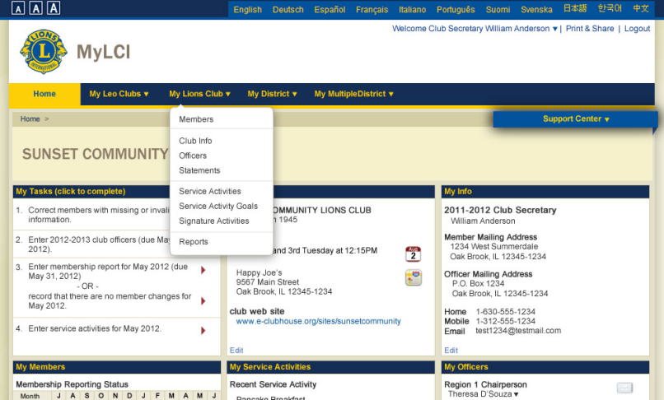
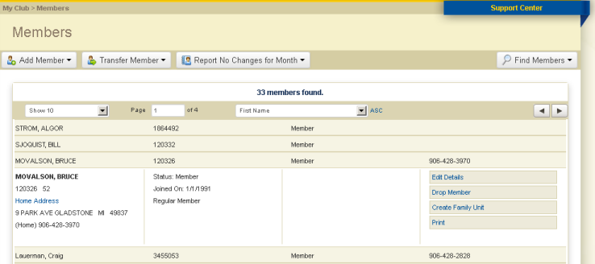
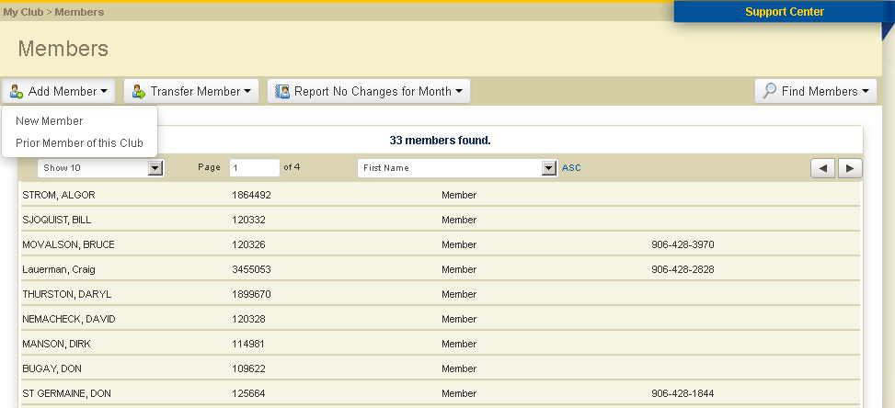
Notes:
To view your members, select Members from the * My Lions Club menu.
A list of the members in your club is displayed. * In the middle of the page you have settings to control sort order, number of members to view per page and which page to display. There you should see your member’s details.

Slide 21
"MyLCI" Preview
Training Site
“MyLCI” Access and Login
Site Overview
Viewing Members
Club Statements
Opt-out of receiving paper statements
Make Payments
Reports
Notes:
Now let’s move on to * “MyLCI” and club statements.

Slide 22
Online Statements
Statements:
View them the day they are generated
View them from as far back as 2010
Can be viewed by club and district officers
Notes:
Before we continue with our preview I want to point out a few things about club statements within “MyLCI.”
* One great benefit of “MyLCI” is that you can view your club’s statements online the day they are generated. You will no longer have to wait to receive it in the mail.
* You will be able to view past statements and semi-annual dues billing invoices from as far back as December 2010.
* The club’s statements can be viewed by club, district, and multiple district officers.

Slide 23
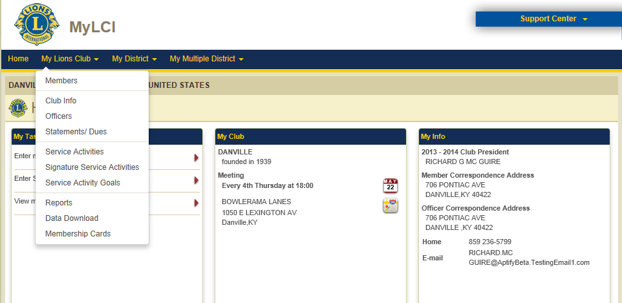
Notes:
So back to our MyLCI preview. To access your club’s statement, you will go to the My Lions Club menu and select Statements / Dues.

Slide 24
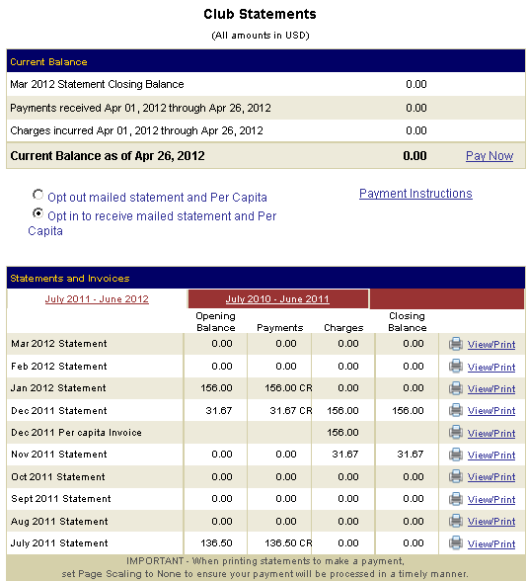
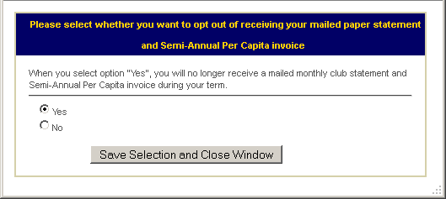
Notes:
The first time you access this area, * you will be given the option to opt-out of receiving paper statements. What this means is you can choose to no longer receive statements in the mail. With this option, you will have to visit the website to view your statement.
Once you make a selection on continuing to receive paper statements or not, that selection will remain in effect until the end of your term. Any time you want to change your selection, simply return to the Statements page.
After making your selection on how your statements will be delivered, the club statement main page will become visible. *
There are three sections of the page.
* The top of the page shows the current balance for the club. One thing to note is * the “as of date” in this section. The information in this section is current as of the previous night. So note that once you make a payment it will not be reflected on the statements page until the next day.
* The middle of the page shows your selection for the receipt of your statements and also where you will go to change your preference if necessary before the end of your term. This area also contains a link to an informational page containing Payment Instructions.
Let’s zoom in to see the bottom section in greater detail.

Slide 25
Notes:
The bottom section is subdivided into three tabs which indicate the year of the statement or statements you would like to view.
* On this page, the statements shown are those for the current Lions year. You can click on the previous year’s tab * to view the statements from that year.
If you want to see or print a statement, let’s say the statement from April of 2013 for example, * just click the View / Print link on the right.

Slide 26
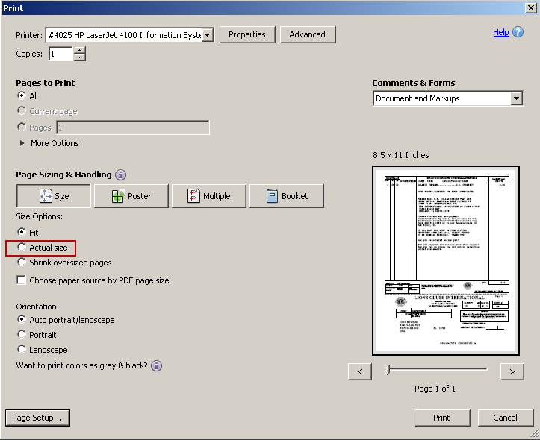
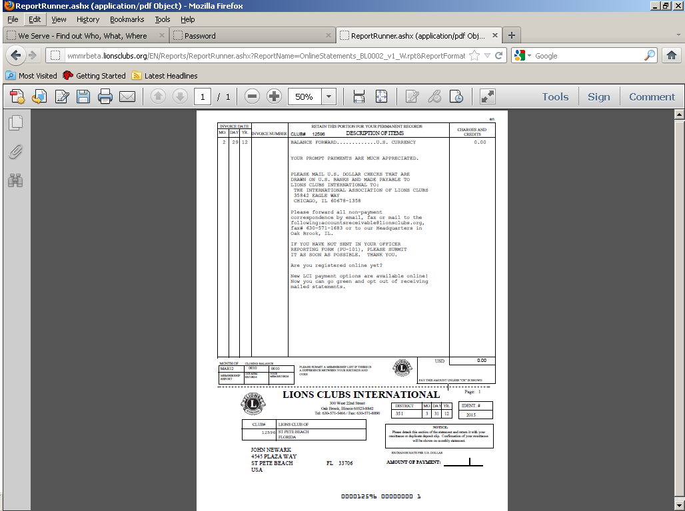
Notes:
After clicking the link the statement will open.
* You will then be able to enlarge the image via the magnification options as well as * save or print the statement. * When choosing the print icon, your print set up page will display. Depending on your browser, you will want to select the “Actual size” print option or set your Page Scaling option to “None” before clicking Print.
After printing your statement, *click the back button on your browser to return to the Statement page. If you are ready to pay, click the “Pay Now” link to process your payment online.

Slide 27
Notes:
If you will be mailing in your payment, click “Payment instructions” for information on where to send your payment.

Slide 28
Online Payments
Payments are processed via the Chase payment website.
Partial payments are allowed.
Payments can be made with a credit card or with an electronic check.
VISA, MasterCard, Discover Card or American Express
Notes:
There are a few things I want to mention about making online payments. When making payments, you will be directed to our Chase payment website. You will be able to make full or partial payments. When making partial payments, the amount paid will be applied to your oldest balance first. Lastly, payments can be made via a credit card or, for clubs that have a US bank, a withdrawal can be made directly from your account via an electronic check, also known as eCheck.

Slide 29
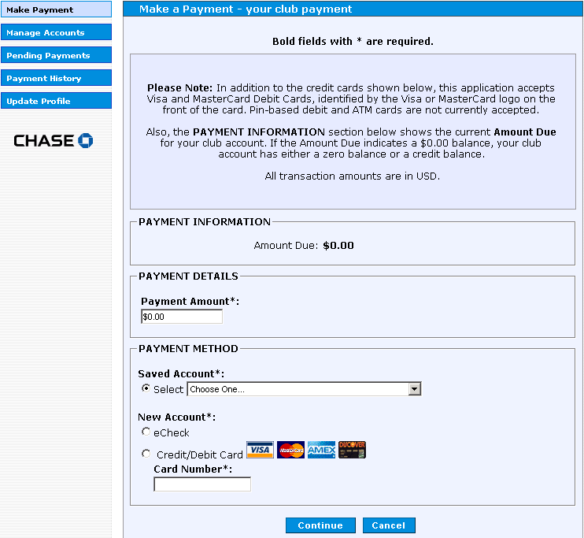
Notes:
So here is what the Chase payment website looks like.
* The current amount due is what will be initially displayed although you will be able to make partial payments and * enter that amount in the payment amount section. After entering the amount you would like to pay, * you will select your payment method of either a credit card or eCheck. You will then be prompted to enter the appropriate information for your credit card or checking account depending upon your selection. I want to point out that you will be able to save this information for easier access in the future, preventing you from having to enter this information each time you make a payment. * When you do this, your information will available within the “saved account” section.
With all payment information entered, * you will then click “Continue” where you will receive a confirmation message if everything was entered properly and your payment accepted. You will also need to enter an email address to receive a receipt or confirmation of your payment as well.

Slide 30
"MyLCI" Preview
Training Site
“MyLCI” Access and Login
Site Overview
Viewing Members
Club Statements
Opt-out of receiving paper statements
Make Payments
Reports
Notes:
Let’s talk about how to * access the pre-formatted membership reports that are available in MyLCI.

Slide 31
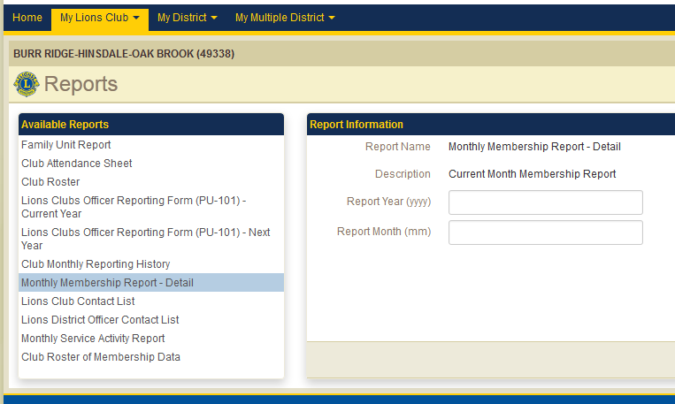
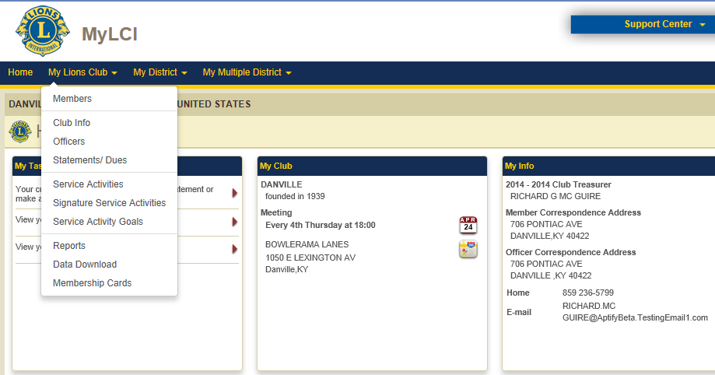
Notes:
From the “My Lions Club” menu, simply select * the Report option. From there you will see the list of reports available to you such as the club roster and a copy of the monthly membership report. You can also export or download membership data from this section as well.
That completes our review of "MyLCI“. Here are some of the frequent questions club treasurers have. Let me know if you think of any additional questions.

Slide 32
Club Treasurer FAQs
Why is it important to establish two bank accounts?
Notes:
First * the importance of the establishment of two accounts. The co-mingling of administrative and fundraising funds is not allowed, meaning funds received from fundraising cannot be used to pay dues or other administrative expenses. The only exception is if the club approves a transfer of funds from administrative to fundraising. Having an administrative account and a public/fundraising account assists with keeping the funds collected for each separate. There may some confusion on this topic. LCI used to tell clubs that they had to have TWO separate bank accounts. You know how redundant that is. Many clubs simply ignored this and developed their own systems of dividing their funds into two (OR MORE) accounts. Our Club used to have FIVE funds! *

Slide 33
Club Treasurer FAQs
Why is it important to establish two bank accounts?
Are there any exceptions to regular billing amounts?
Notes:
You can use EXCEL or other programs to keep track of your funds. *
Another frequently asked question is “Are there any exceptions to regular billing amounts?. Are there times when a club can expect billing beyond regular membership dues?”. The answer is yes. Outside of membership dues, remember all new members incur a one-time new member fee of $25. (soon to go to $30) Another scenario where there will be a change in the membership dues amount is if the new member is a student or family member, in which their dues is half of the normal dues amount.

Slide 34
Club Treasurer FAQs
When is credit issued for semi-annual dues invoices?
Notes:
When can credit be issued for semi-annual dues invoices? Semi-annual dues invoices are issued in December and June, and credit is given for those invoices in January and July, only if membership is adjusted. I encourage you to make yourself aware of the terms established by LCI and for the District and State. You can eliminate frustration and protect your club’s funds by being aware of all members’ status and share responsibility with your secretary in viewing the membership at a minimum, during the months of November and May. I also urge your club to begin your dues billing cycle earlier than July 1, the actual start of the year. If your club is typical to most, you probably have a ‘few’ members who don’t send in their payment the very day they receive a bill. And you may have to send reminder notices. We usually start billing members in May, so by July 1 when we get the dues billing from LCI, we’ve already collected most of the dues. And you may have received a few replies from members who tell you they are not renewing- A GREAT time to reach out to the. (Why do we wait until dues billing to reach out to members anyway?)

Slide 35
Club Treasurer FAQs
When is credit issued for semi-annual dues invoices?
What is an annual audit and why is it important?
Notes:
* “What is an annual audit and why is it important?” The annual audit of the financial records can be done by a respected past officer. The audit confirms that the records were in good order at the end of the year. An audit should be done each year regardless of a change in treasurer. In all fairness, we should probably refer to this process as a review. In true accounting terms, an audit is far too extensive for most clubs to expect. A review is an opportunity to make sure income and expenses are in balance and that property authority has been given in the movement of funds, both deposits and checks.

Slide 36
Club Treasurer FAQs
When is credit issued for semi-annual dues invoices?
What is an annual audit and why is it important?
How can I ensure my club remains in active status?
Notes:
* “How can I ensure my club remains in active status” is another very common question treasurers have. Simply put, you should pay all of your dues within the terms established by the association and do not allow billing to go unpaid beyond 90 days of the due date. Your district governor will be notified immediately when you fall behind in your financial obligations to LCI. You don’t want this to happen.

Slide 37
Agenda
Review position responsibilities
Identify benefits “MyLCI” provides club treasurers
View demonstrations of club treasurer “MyLCI” features and functions
Notes:
So far during this training we have:
* Performed a high level review of your responsibilities as club treasurer
* Identified the benefits “MyLCI” will provide you
* And we reviewed the “MyLCI” functions and features that you will be performing in the system
This session provided you with a lot of information on the your role as club treasurer and how “MyLCI” will assist you. While you may not be an expert on all of “MyLCI’s” features, this first look of the new system and how to perform your associated tasks will allow to you help your club be effective and in compliance.

Slide 38
Support Center
mylci@lionsclubs.org
630-468-6900
Accounts Receivables and Club Account Services
membershipbilling@lionsclubs.org
Notes:
If you have questions about “MyLCI” or anything that you saw demonstrated during today’s session, please contact the support center at LCI Headquarters, which is open from 8:30 AM – 4:30 PM Chicago time, Monday thru Friday.
For other billing and treasurer specific questions, please contact the Account Receivables and Club Account Services department.

Slide 39
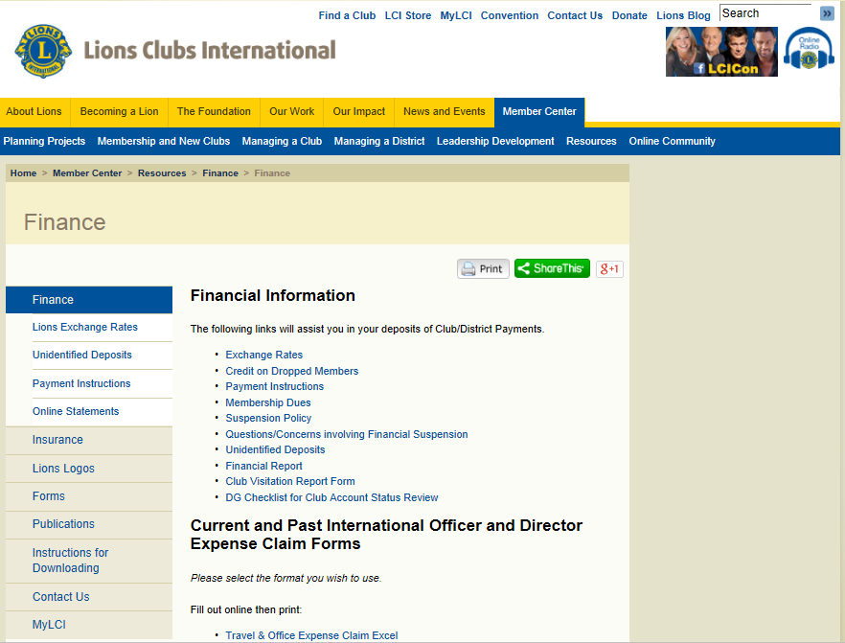
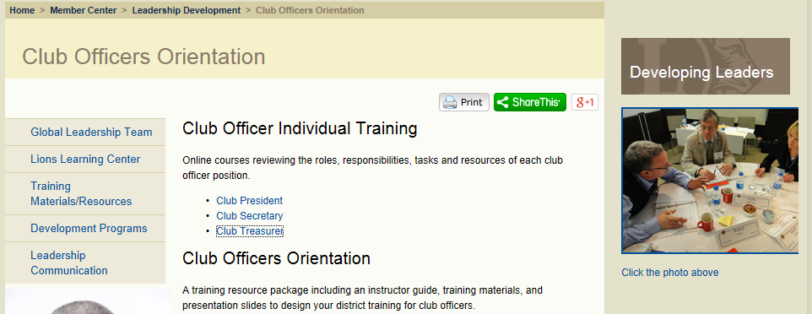
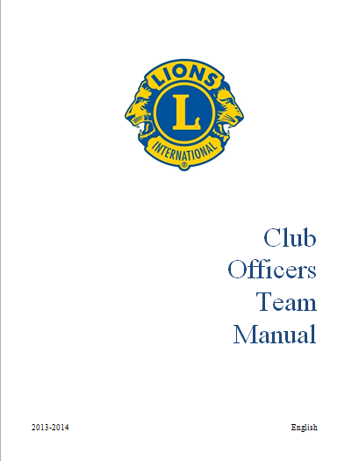
Effective Meetings Webinar in January 2014
Club Treasurer Resources
Notes:
* The Club Constitution & Bylaws and the Club Officer Manual, both available on the LCI website, are the primary resources for you to reference as club treasurer.
* As mentioned earlier, the Leadership Resource Center has a Club Treasurer Self-Study module that you can view at your leisure.
* Lastly, you can also find a variety of resources within the Finance section of the Member Center on the LCI website.
.

Slide 40
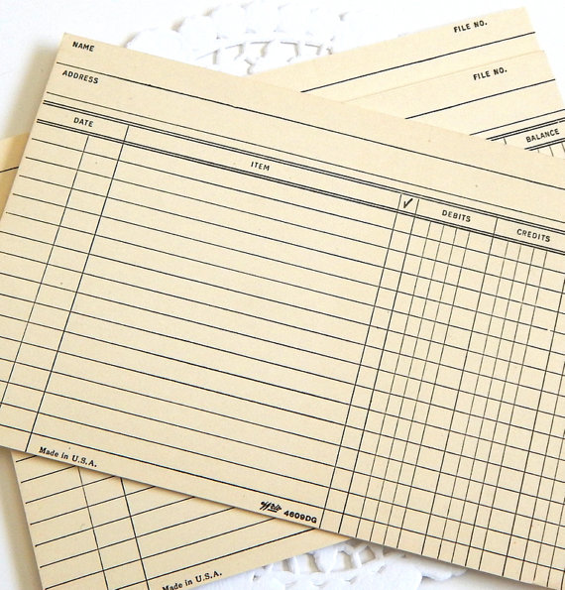
Notes:
Once you’re acquainted with MyLCI, the decision on how to track your club’s income and expenses must be made. Early club treasurers probably relied on hand posting in dingy yellow ledger books. Elaborate secret codes were used to correctly enter data in the correct sheets, making sure all the credits and debits were properly listed and all totals were in balance. * Believe it or not, this was the basic design for the original spreadsheet programs such as Excel. For many clubs, a simple spreadsheet is quite sufficient to track income and expenses.

Slide 41
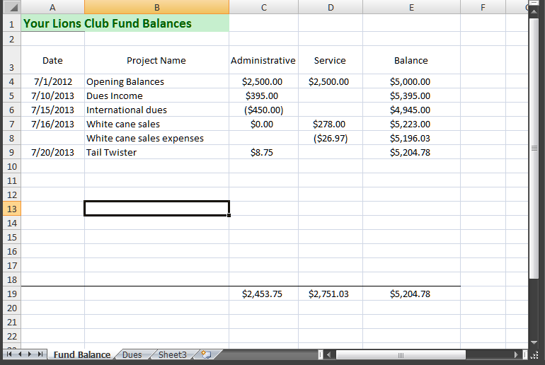
Club Treasurer Resources
Notes:
Here’s a simple spreadsheet used to show a club’s checkbook balance. Notice how it’s split to show both the administrative and service funds?

Slide 42
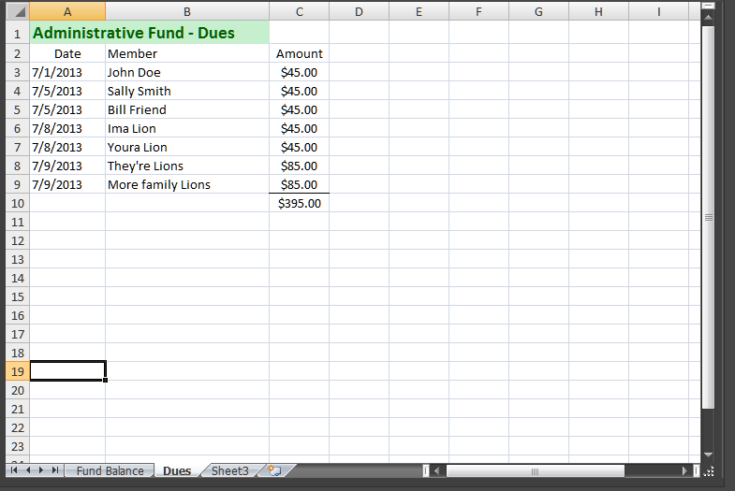
Club Treasurer Resources
Notes:
This sheet provides detail for a specific deposit entered on the previous slide. Notice how each item for that deposit is detailed? Before going on, it is important for the treasurer to maintain complete records of every transaction. If you’re like me, at every meeting Lions come up and ‘toss’ money (cash or checks) and simply tell me what’s for. I take that amount, put a sticky note on it and put it an envelope (or zip lock back). When I get home, I would never remember what happened. Now you can enter the details and if asked later by Larry Lion if he paid for his chicken tickets, dues or whatever, you can research the date and reply.

Slide 43
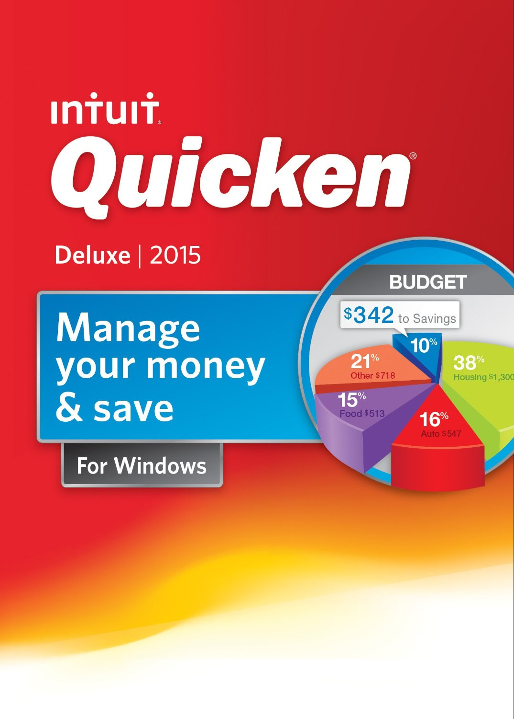
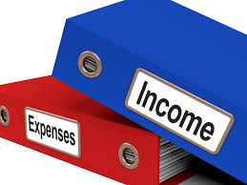
Notes:
There are other ways to keep your club’s records. Over the years, there have been numerous accounting software titles developed, but the most common for the non-accounting personnel come from Intuit.
Quicken is the most common program used by individuals and organizations. It is, by its very name, very INTUITIVE. * The company also produces Quickbooks, sort of Quicken on steroids. Better, it has a lot of features for businesses. Many accounting firms are using Quickbooks with their clients who do a lot of their own accounting.

Slide 44
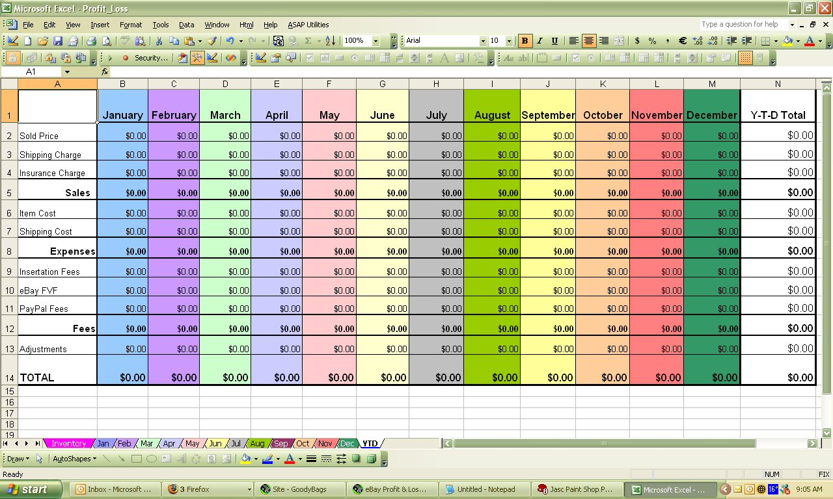
Notes:
Whatever you decide to use, be sure to identify your club’s income and expense accounts carefully. Programs such as Quicken and Quickbooks are extremely flexible in helping you create reports, even downloading them into Excel spreadsheets. The secret to using any of them is to be accurate with your information. The devil is in the details!

Slide 45
Notes:
Now comes the alphabet soup portion of this presentation. EIN, TIN, 990, 990-EZ, 990-N, IRS, SOL, NOOOOO! To help you out, the following information is all available on a handy sheet,

Slide 46
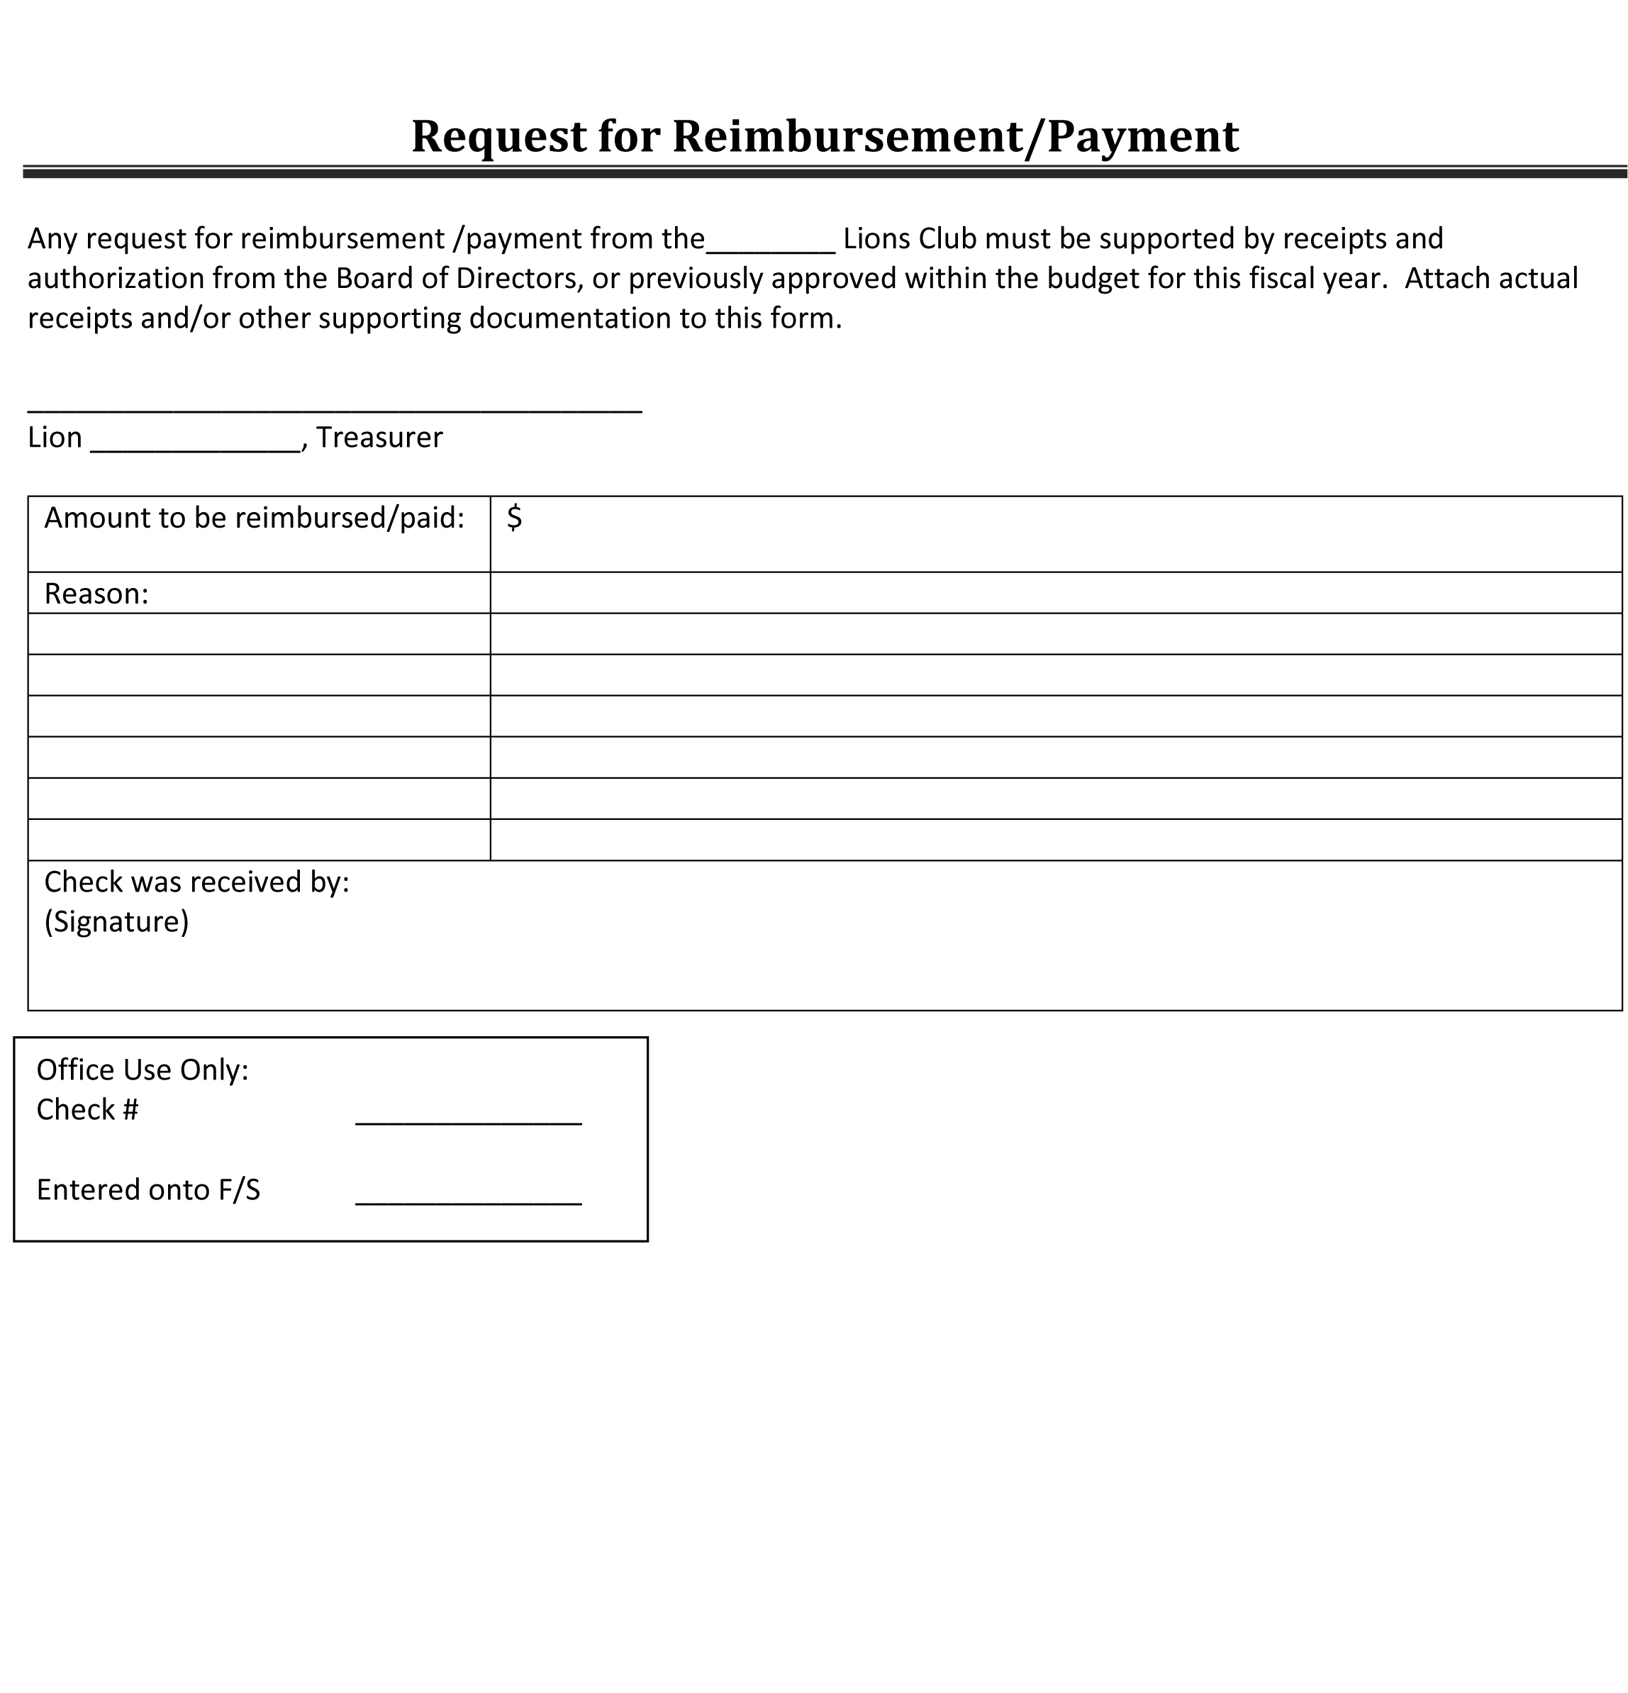
Payment Request
Notes:
Some type of payment authorization request will document the approval for payments.

Slide 47
Document Link-
Tax issues and regulations affecting Lions Clubs and Leadership
Lions25g.org
Notes:
Go to district website, click on

Slide 48
Notes:
Navigate to my district’s website, lions25g.org. In the menu, select the Documents item, and then a list of options appear in a drop down box. Select the Tax Regulations and Issues item and you’ll download a PDF with all the details that will follow.

Slide 49
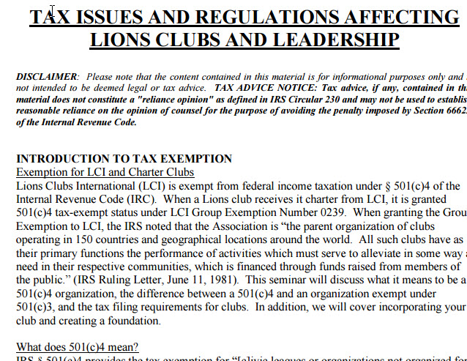
Notes:
This document will be your guide through all the important forms and dates you’ll need to be aware of as club treasurer. Let’s start with an introduction to Tax Exemption. (refer to the actual sheet and briefly go through the sections.) FYI, this document also has the Payment request discussed ealier.

Slide 50
Fed EIN Number
Notes:
TAX FILING – CLUB RESPONSIBILITIES
Obtaining an EIN. Every Club and/or District must have an employer identification number (EIN), even if it will not have employees. The EIN is a unique number that identifies the organization to the Internal Revenue Service. To apply for an EIN, you should obtain a Form
SS-4 and its Instructions from the IRS. You may also apply for an EIN online(www.irs.gov/charities), by telephone (1-800-829-4933), or by fax (fax number at the location accepting applications from your state).It is important that the Clubs and Districts are using the correct EIN for their annual filing. Failure to use the correct EIN will result in revocation of the501(c)4 exemption. Should your Club or District have the wrong EIN, you may correct the records with the IRS through their Exempt Organizations(EO) customer service at 877-829-5500.

Slide 51
Filing Requirements
Notes:
Filing Requirements. Under the Pension Protection Act of 2006, most small tax-exempt organizations whose gross receipts are normally $25,000 or less($50,000 or less for taxyears2010 and later) must file Form 990-N,Electronic Notice (e-Postcard) for Tax-Exempt Organizations not Required To File Form 990 or 990-EZ. Before this law was enacted, these small organizations were not required to file annually with the RS. This means that ALL clubs and districts must annually file a990-N, 990-EZ or 990.
E-Postcard Filing. If your club is eligible to filea990-N, then it must provide the following information on the 990-N: the club’s legal name; any other names the club uses; the club’s mailing address; the club’s website address (if applicable); the club’s taxpayer identification number (TIN or EIN); name and address of principal officer of the organization (President); the fiscal year the club runs by which should be June through July; a statement that the club’s annual gross receipts are normally $25,000 or less ($50,000 or less beginning with the 2010 tax year); and if applicable a statement that the club has been canceled or is planning on canceling.
When to file: Forms 990, 990-EZand 990-N must be filed by the 15thdayof the 5thmonth after the end of the organization’s annual accounting period. For example, if the club’s tax period ends on December 31, 2011, the form is due May2012. Please note that an organization cannot request an extension for filing the Form 990-N.
Revocation: If a Lions Club or District fails to file timely a Form 990, 990-EZ or 990-N, then their exemption will be revoked by the IRS. This is regardless of whether they are part of a group exemption like Lions Clubs or Districts. The IRS issued instructions for organizations wishing to get reinstated. As part of this, the IRS issued guidance on how organizations can apply for reinstatement of their tax-exempt status, including retro-active reinstatement. In addition, the IRS announced transition relief for certain small tax-exempt organizations–those with annual gross receipts of $50,000 or less for 2010 –that were made subject to the new "postcard“ filing under the Pension Protection Act. The relief allows eligible small organizations to regain their tax-exempt status retroactive to the date of revocation and pay a reduced application fee of $100 rather than the typical $400 or $850 fee. Full details are available in Notice2011-43, Notice 2011-44and Revenue Procedure 2011-36, issued by the IRS. If an organization appears on the list of organizations whose tax-exempt status has been automatically revoked, it is because IRS records indicate the organization had a filing requirement and did not file the required returns or notices for three consecutive years. Any organization that wishes to receive retroactive reinstatement under the new rules has to file an application for recognition of exemption. Therefore, either a Form 1023 or 1024 has to be filed EVENIF they didn’t have to file one initially, such as an organization covered initially under a group exemption like Lions. There are two processes from there, depending upon what filing was missed resulting in ), by telephone (1-800-829-4933), or by fax (fax number at the location accepting applications from your state). It is important that the Clubs and Districts are using the correct EIN for their annual filing. Failure to use the correct EIN will result in revocation of the 501(c)4 exemption. Should your Club or District have the wrong EIN, you may correct the records with the IRS through their Exempt Organizations (EO) customer service at 877-829- 5500.

Slide 52
Incororation Benefits
Limited Liability
Property Ownership
Notes:
Limited Liability
In most jurisdictions, individual club members are not liable, individually or severally, in lawsuits against the club. Liability is limited to the capital or assets of the club.
In most jurisdictions, individual club members are not liable, individually or severally, in lawsuits against the club. Liability is limited to the capital or assets of the club.

Slide 53
Budgets
Notes:
This past year when I agreed to develop and give this presentation, I was asked to be sure to include a section on budgeting. This does not have to frightening process. It is simply a projection of what you expect to take in (income) and spend (expenses) for the coming year. Budgets are done best if you us historical (HYSTERICAL?) information. It can be as simple as reviewing your bank account and list your activity in these two areas, and then project what you expect will happen in the future. Be sure to consider anomalies in what happened this past year. (rainout at county fair project)

Slide 54
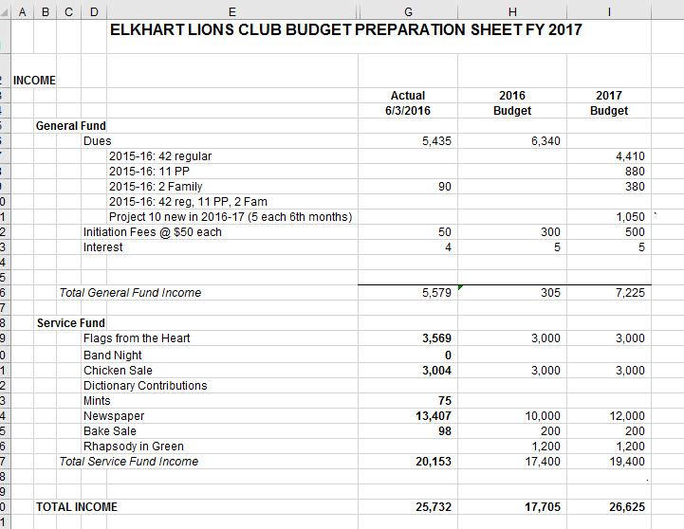
Notes:
Here is a typical way you can show your anticipated income for the year. Note how I broke down the anticipated income for each dues type. When we develop our budget, usually in mid-June, we use YTD actual results to predict next year’s amounts.

Slide 55
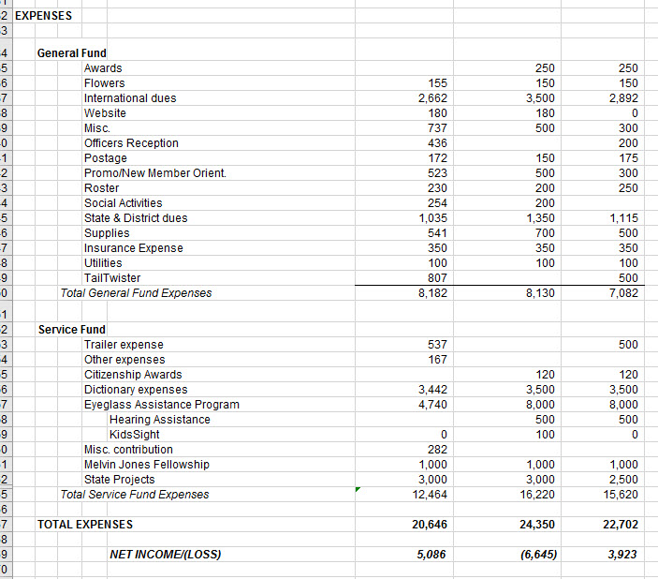
Notes:
This is the expense side of the budget. When done, you can see show an expected profit or loss. Don’t let the word profit bother you. Just because Lions clubs are ‘not for profit’ organizations, doesn’t mean they can’t have a profit. Does anyone know what the meaning of ‘not for profit’ is?

Slide 56
Thank You!!

